Slide 1
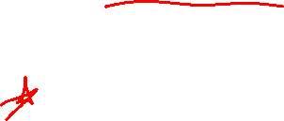
Section 2.8 One-to-one Functions and Inverses
Lecture 1
Idea of reversing functions
Notes:
Note, skip 2.5, more on lines, focus is on thinking linear. Similar ideas to previous lectures

Slide 2

Section 2.8 Homework Submission to Canvas
Preview of section
Skim the section in text and write a short paragraph summary.
Give a bulleted list of all important definitions, theorems, and formulas without details.
Notes on video lectures
Take notes on everything written on slides including all details, worked examples, on-own activities, as well as your own thoughts and questions.
Try on-own activities first, then write down provided solution next to it for comparison.
Worked examples from the text
Write down the problem and attempt without looking at the solution.
Use the solution to write the best explanation you can.
Solutions to textbook exercises
Model approaches and explanations given in the video lectures and textbook examples.
Final reflection of section
List the key takeaways to remember as a bulleted list.

Slide 3
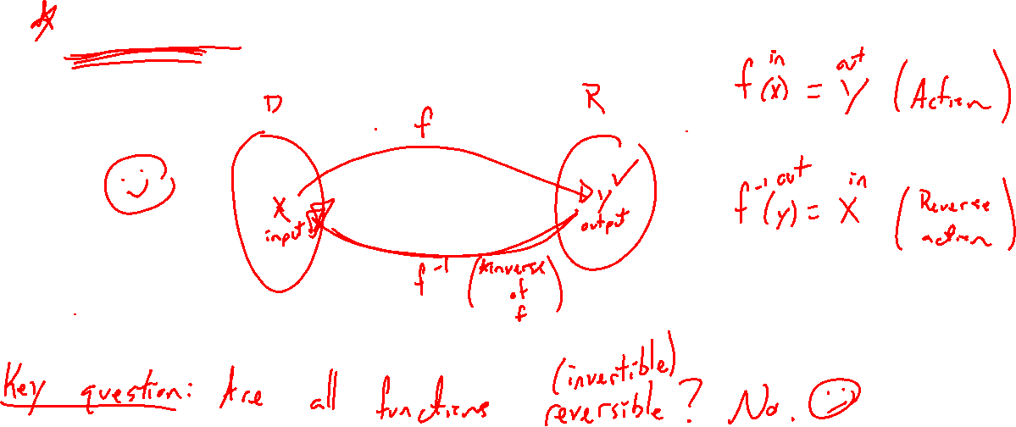
Reversing a Function Idea
Notes:
Thinking of a function as an action, how to reverse this action? Reverse is called the inverse function.
Domain/range diagram
Question: Can you always reverse a function? No. Need each output to belong to a single input.

Slide 4
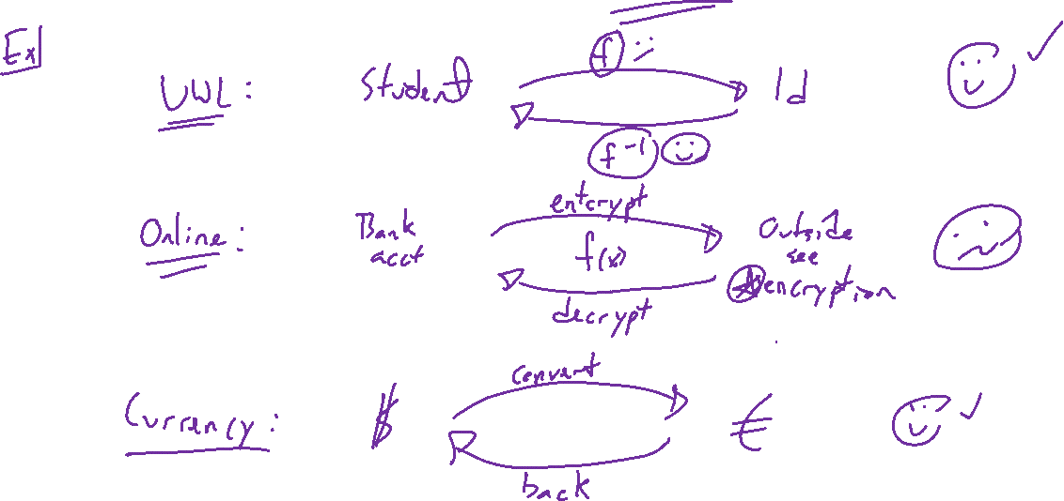
Reversing a Function, Why Bother?
Notes:
Examples: Student to id, encrypt and ecrypt, currency exchange, feet/meters
Need certainty for reversing.

Slide 5
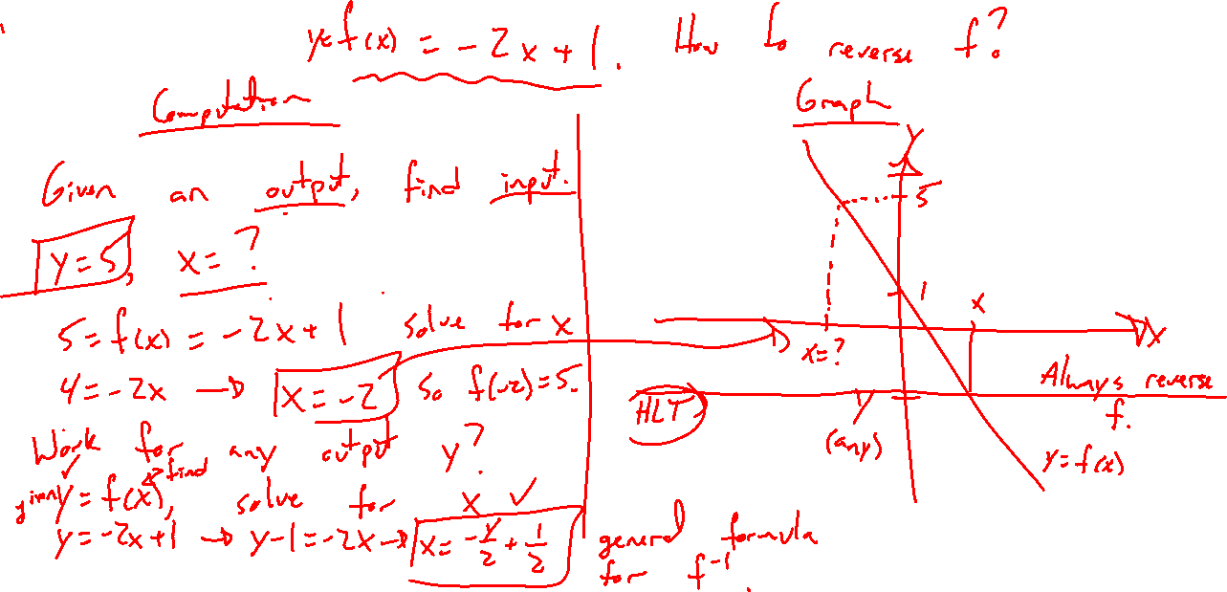
Example:
Notes:
F(x) = -2x+1
Given and output, find the input. Y=-3,5
General y
New function x=f^{-1}(y) is the reverse mapping of f

Slide 6
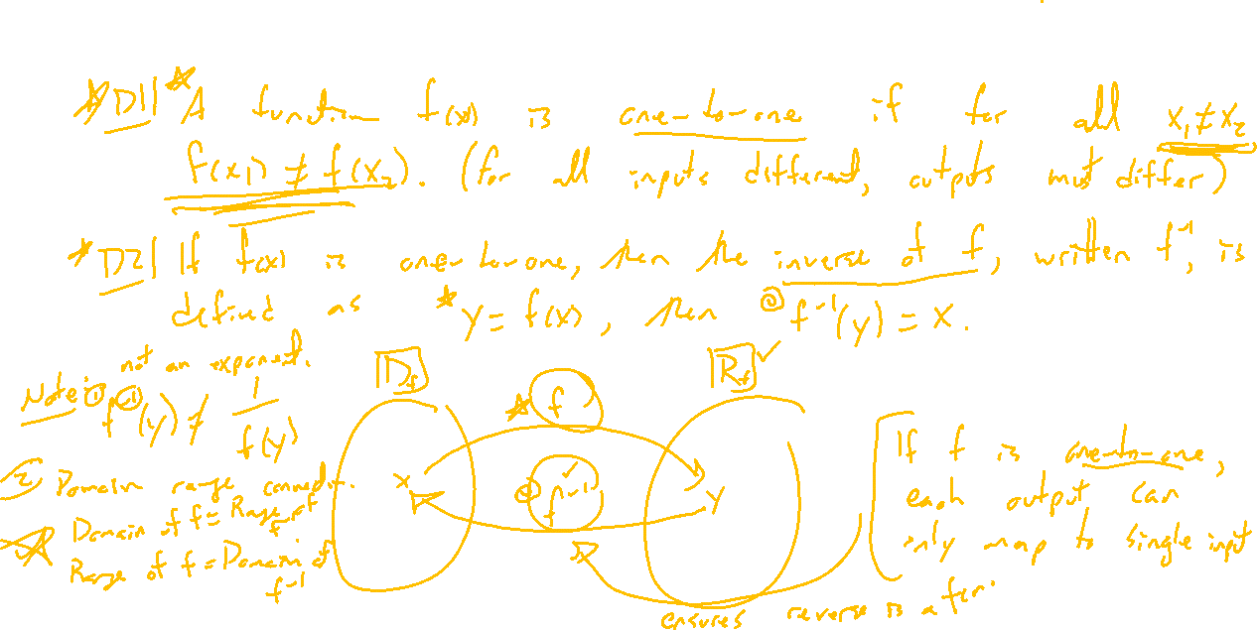
Definitions
Notes:
Careful definitions:
One-to-one function
Inverse function
Diagram: function composition identities
Flip of domain and range

Slide 7
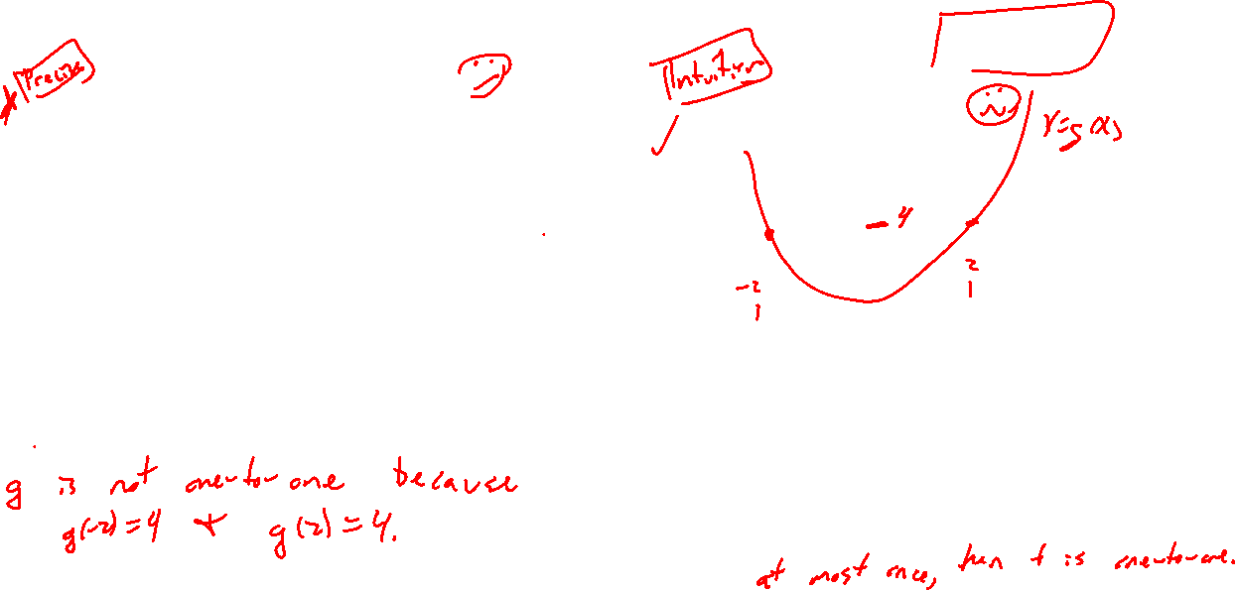
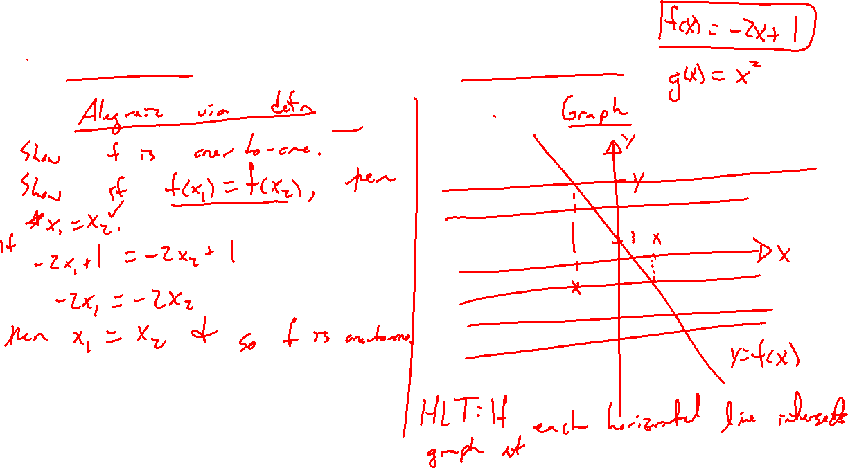
Example: How to Tell if One-to-one
Notes:
F(x) = -2x+1, g(x)=x^2
2 ways, definition, graph (HLT).

